Slide 1
The Blurse of Dimensionality
Dr Huw Day (he/him)
Huw.day@bristol.ac.uk

Slide 2
“Visualising 9 dimensional space is easy: just visualise n-dimensional space and then let n=9.”

Slide 3
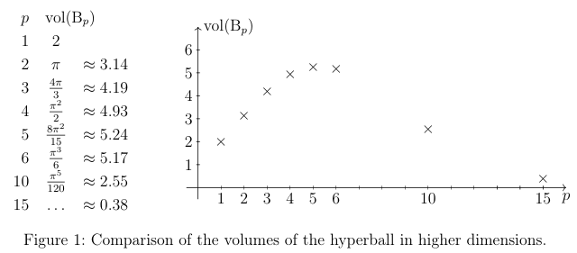
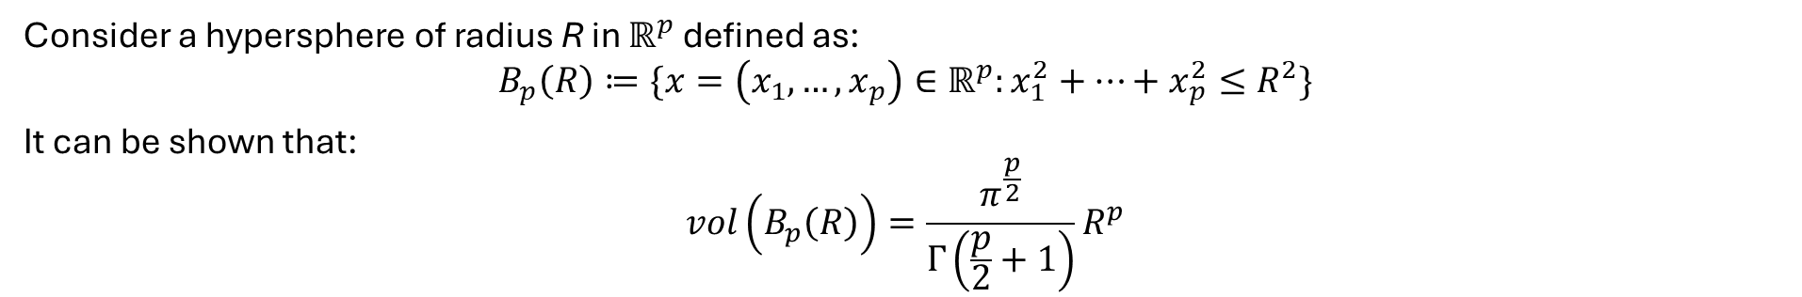
A rather excitable sphere
Consider a hypersphere of radius R in $ℝ^{p}$ defined as:
$$B_{p}\left(R\right)≔\{x=\left(x_{1}, …, x_{p}\right)∈ℝ^{p}:x_{1}^{2}+…+x_{p}^{2}≤R^{2}\}$$
It can be shown that:
$$vol\left(B_{p}\left(R\right)\right)=\frac{π^{\frac{p}{2}}}{Γ\left(\frac{p}{2}+1\right)}R^{p}$$
Figure from: https://rolandspeicher.com/wp-content/uploads/2023/08/hda_rmml.pdf

Slide 4
How can we think about high dimensional space?
In high dimensions:
Any two vectors in the hypersphere are almost orthogonal
The volume of a hypersphere is concentrated close to its surface

Slide 5
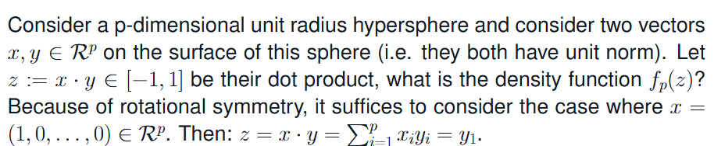
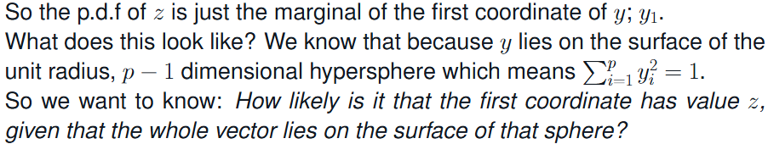
Any two vectors in the hypersphere are almost orthogonal

Slide 6
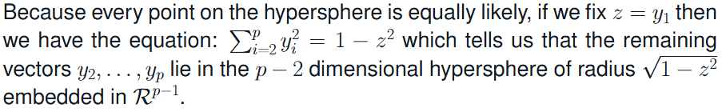
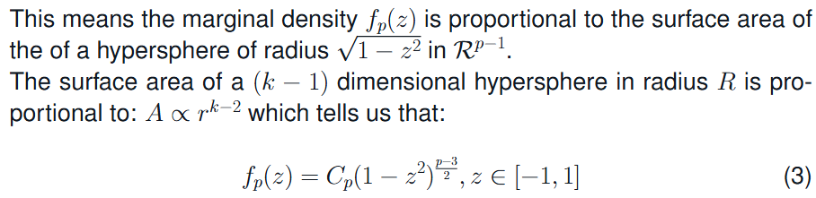
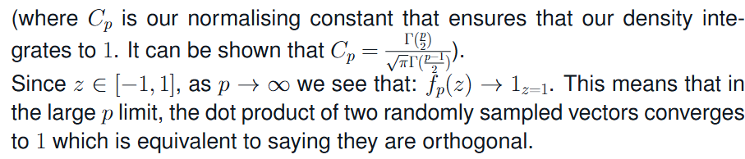

Slide 7
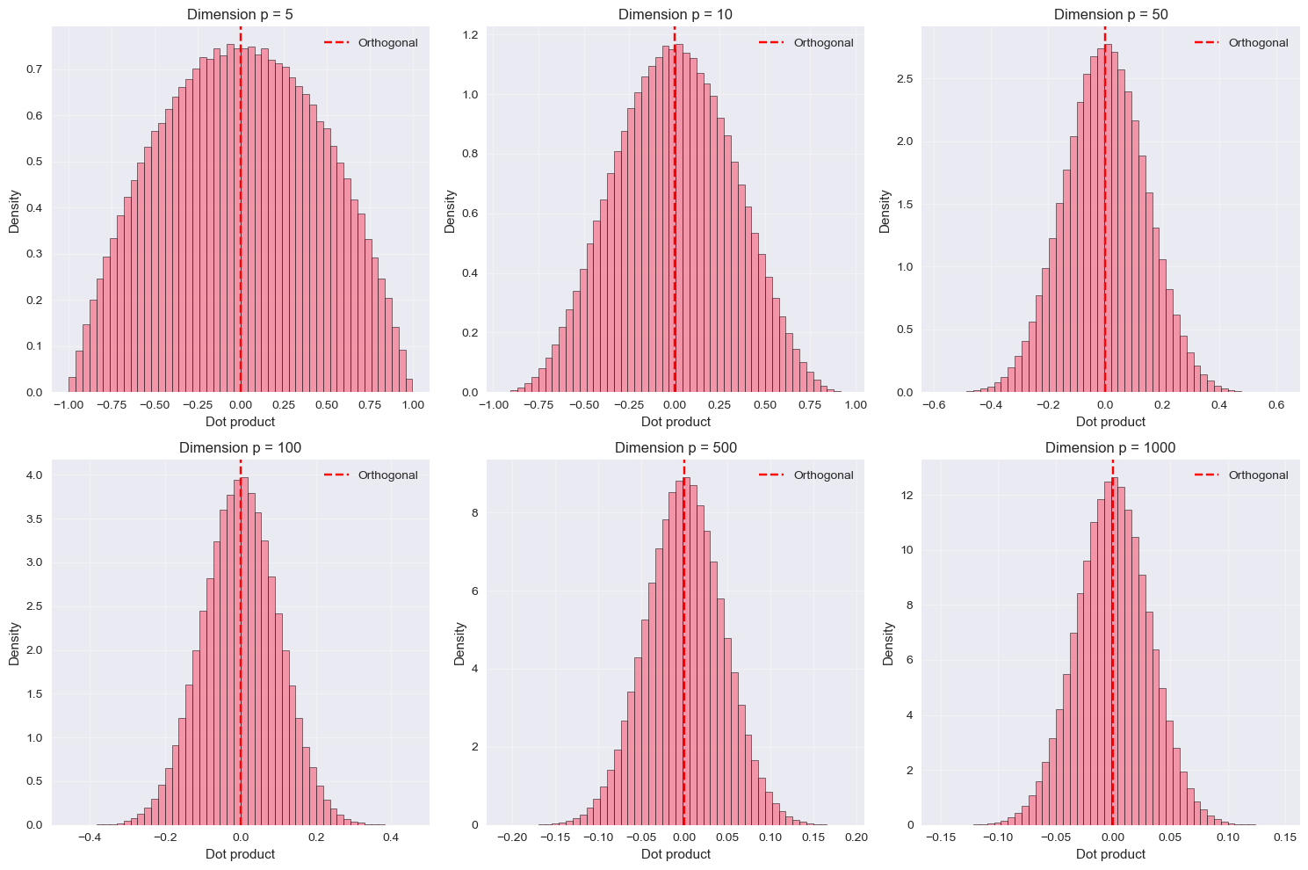

Slide 8
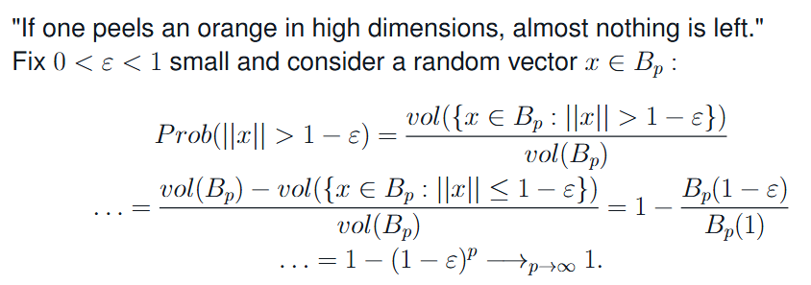
The volume of a hypersphere is concentrated close to its surface
Notes:
Intuitively, the probability of the norm of a random vector inside the unit hyperball being epsilon far from the surface is just the ratio of the volume of the 1-epsilon hyperball divided by the volume of the unit hyperball
For fixed epsilon between 0 and 1, this probability grows to 1 as the dimension grows large.

Slide 9
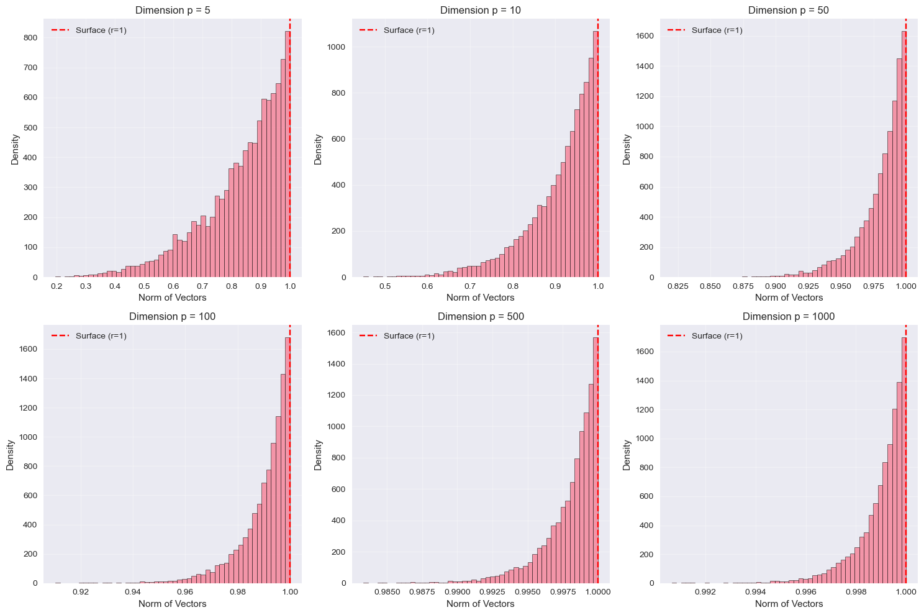

Slide 10
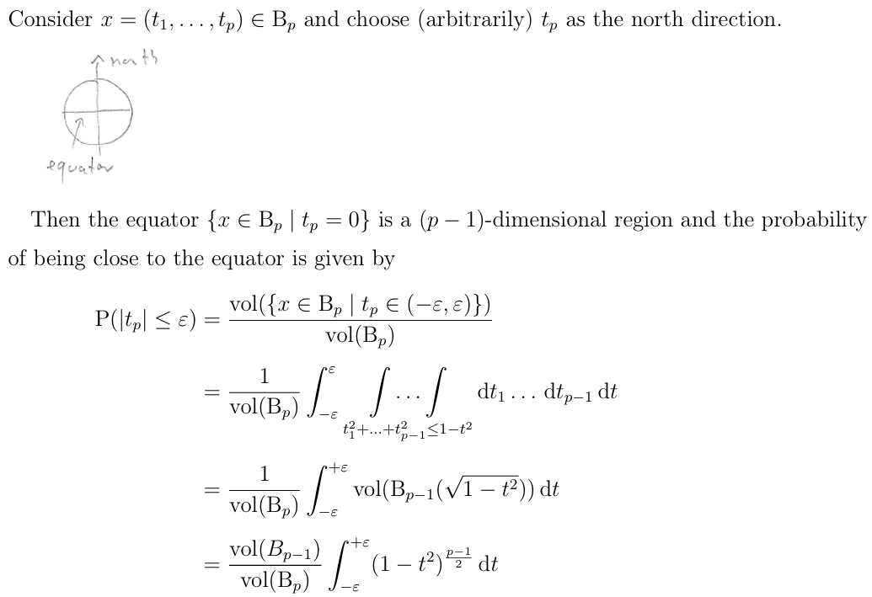
Almost all the volume of the hypersphere lies near its equator
Plot of probability of |t_{p}| less than epsilon for increasing values of epsilon
Integral approaches sqrt(2pi/ p) from above

Slide 11
Blessing or Curse?
Data gets sparse and it becomes increasingly difficult to sample the densities of distributions in high dimensions.
Many random vectors and random matrices behave close to deterministically, making it much more routine to sample smooth, 1 dimensional functions of high dimensional vectors.

Slide 12
Acknowledgements/References
The content of this poster is inspired by the notes and recordings of Roland Speicher's graduate course "High Dimensional Analysis: Random Matrices and Machine Learning" (https://rolandspeicher.com/lectures/course-on-high-dimensional-analysis-random-matrices-and-machine-learning-summer-term-2023/) [1].
Some of the figures were generated by Fahd Abdelazim from the Ask-JGI data science helpdesk (ask-jgi@bristol.ac.uk) code available on GitHub (https://github.com/HuwWDay/BlurseOfDimensionality) [2].

Slide 13
“The literature on machine learning is also in high dimension so you can get lost very easily.” – Roland Speicher

